Slide 1
DMIT 1006 OA01
Seonhye Yoon
+
Value Proposition
Presentation
Episode Hyperlink
PPT Record Hyperlink
01
Instructor: Yvonne Bouchard
Notes:
Hello, I’m Seonhye Yoon, and today I’ll talk about the Value proposition.

Slide 2
+
Index
01
02
03
04
Value Proposition
Customer Segments
Customer Relationship
Channels
02
Value Proposition Presentation
Notes:
Here is the index for presentation.
Firstly I’m going to say about value proposition, then Customer segments, and pass to the Customer relationship and last one is Channels.

Slide 3
01
+
Value Proposition
Company Introduction
Gain Creators
Pain Relievers
03
01. Value Proposition
Notes:
So! In the value proposition, I want to say about the company what I chose, and their gain creators and pain relievers.

Slide 4


+
What
kind of company
is this?
04
Source: https://www.google.com/search?q=tdot+performance&client=firefox-b-d&sxsrf=AOaemvIc3C0UhF5IfZW3lDmCuSuatKgFIw:1634253170431&source=lnms&tbm=isch&sa=X&ved=2ahUKEwi81ci9g8vzAhUTKH0KHZ62BTgQ_AUoAnoECAEQBA&biw=1920&bih=927&dpr=1#imgrc=lZJ3lL_YRIkYVM
Notes:
I chose the TdotPerformance. This company is from the Dragons’ Den’s 8th episode in season 10.
So What kind of company is this?
They sells high quality performance parts and accessories for cars at low-cost.

Slide 5

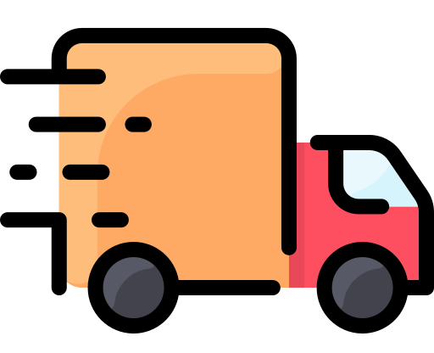

+
Gain Creators
01
02
03
Searching fit parts
Delivery
Low Price
https://www.flaticon.com/premium-icon/searching_2170040
https://www.flaticon.com/premium-icon/delivery-truck_3091609
https://www.flaticon.com/free-icon/discount_3375341
05
01 Value Proposition
Notes:
Here is the three gain creators for TdotPerformance.
First, Searching fit items. There are too much items for each vehicles, so customers have to consider that product is suitable for their autos. However, TdotPerformace has their searching engine to get products by customers’ car makes, model, and the year. Therefore, Customers don’t need to consider that product will fit theirs.
Then, Delivery.
Sometimes the performance parts and accessories for autos are hard to carry it. However, this TdotPerformance delivers to the customers’ house or place where they want. Even with free delivery fee if it’s in Canada.
Lastly, Low Price.
They sells items at cheaper price than other offline shopping malls. Because they are 100% Canadian owned, they do not charge any custom duties or brokerage fees.

Slide 6


+
Pain Relievers
01
02
Inventories all over Canada
30-Day Easy return
https://www.flaticon.com/free-icon/canada_4498652
https://www.flaticon.com/free-icon/exchange_1585197
06
01 Value Proposition
Notes:
For the Pain Relievers
Deliveries are sometimes slow in Canada. This is because the area of Canada is so large, so they have warehouses all over Canada to solve this problem.
It is a chronic problem of online shopping that it is difficult to return/refund. To solve this problem, TdotPerformance provide the 30-day easy return service which is return the unused, damaged or altered product in any for.

Slide 7
02
+
Customer Segments
Customer Jobs
Gains
Pains
07
02 Customer Segments
Notes:
Secondly, Customer Segments.
This part includes Customers’ jobs, and their gains and pains.

Slide 8




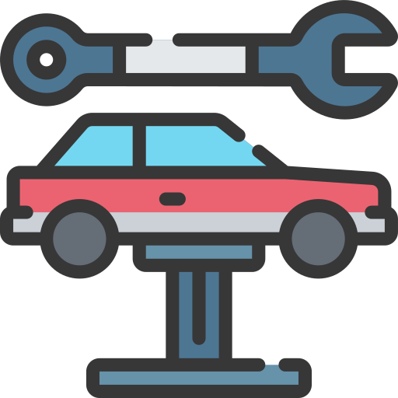
+
Customer Jobs
Finding out what customer needs
Check the product fits their cars
Confirm that
item works well
Fix the car
08
https://www.flaticon.com/free-icon/tyre_5491615
https://www.flaticon.com/free-icon/puzzle_808423
https://www.flaticon.com/free-icon/system_3247987
https://www.flaticon.com/premium-icon/car-repair_1729067
Notes:
Customers’ Jobs.
What they have to do to use this service.
This is not to different when they buy performance parts or accessories for their vehicles from offline.
Customers just need to find out what they need for their cars, such as tires, lightning, and so on.
Then they need to make sure the product fits their cars. It is already sorted out, but just for double check.
Order the items, and after delivery, just confirm that item is right, and works well.
Then fix or just put it in the car.

Slide 9


+
Gains
01
02
03
Lower Price
Rare Item
Accessibility
https://www.flaticon.com/free-icon/discount_3375341
https://www.flaticon.com/premium-icon/reverse-trend_2118232
https://www.flaticon.com/premium-icon/buy-button_3655469
09
02 Customer Segments
Notes:
What is the customers’ gains if they buy the product from TdotPerformance?
First lower price.
Customers can get parts or accessories at lower price than offline shops.
And They also can find some rare items, or products that they can’t find in the offline shop.
The last one is not only for Tdotperformance. It is a characteristic from online shopping. Customers can buy anytime, anywhere when they need.

Slide 10


+
Pains
01
02
Don’t know
how to fix
03
No Item in Inventory
Difficulty to return
https://www.flaticon.com/free-icon/hoarding_2867158
https://www.flaticon.com/premium-icon/confused_4126450
https://www.flaticon.com/free-icon/exchange_1585197
10
02 Customer Segments
Notes:
How about the Pains?
If there is no item in near inventory, it takes long time to get the merchandise.
And if customers don’t know how to fix or install it. They need to visit the car repair center anyway.
Last, Difficulty to return.
They provide 30-day easy return, but it is still difficult and take more time compared to the actual stores. Moreover, Customers still need to pay for the shipping cost if they want to return.

Slide 11
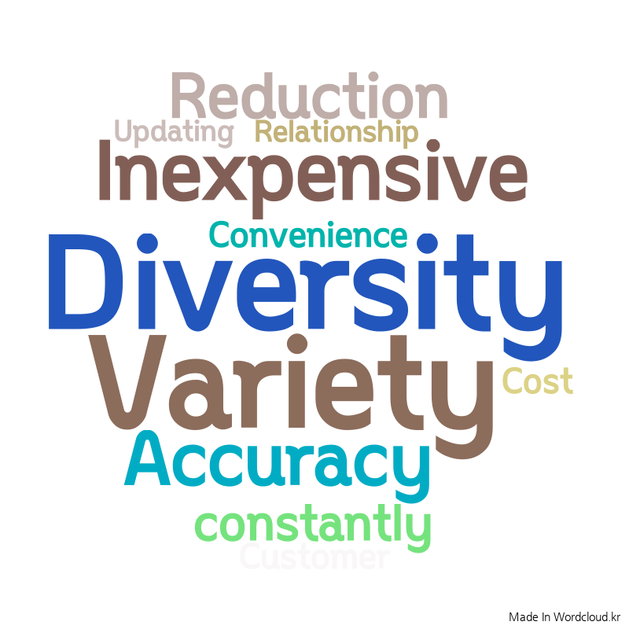
+
03
Customer Relationship
11
http://wordcloud.kr/
03 Customer Relationship
Notes:
About the Customer Relationship.
When I think about customer relationships, these are what came to mind;
Inexpensive/Cost Reduction. it’s because TdotPerformance sells the product at lower cost than the other shops.
Variety/Diversity. They sells a lot of merchandise. Also, even if there is no item in near inventory, they might have same or similar item in other inventory.
Updating Constantly. Brand-new autos and accessories are launched every year and every month, so TdotPerformance updates their product list constantly.

Slide 12
04
+
Channels
Awareness
After Sales
Purchase
12
02 Customer Segments
Notes:
Lastly, Channels.
How TdotPerformance appeals their website to customers?
When provisional customers search for items sold on the site, Promoting items to be at the top of the list.
And purchase.
TdotPerformane has a seach engine that gets results according to the type, model, and year of the car.
They can search by the car details, but also can find by the product what they need. For example, if customer find some specific item and order it, they pop-up to get information about customers’ cars.
Then After sales.
Customers can return easily during the 30-day if they do not use the product or it has the defects.

Slide 13
+
Thank you for
Listening :)
13
Value Proposition Presentation
Notes:
In this presentation I talked about What is the Gain Creators and Pain Relievers for the company, and Customer Segments such as Customers job, and their gains and pains.
Then also talked about Customer relationships and Channels.
Thank you for listening and have a great day!

Slide 14
+
Reference
Presentation Template
https://www.miricanvas.com/templates/presentation/1x5u-%EA%B0%90%EC%84%B1%EC%A0%81%EC%9D%B8-%ED%94%84%EB%A0%88%EC%A0%A0%ED%85%8C%EC%9D%B4%EC%85%98
Images Source
https://www.google.com/search?q=tdot+performance&client=firefox-b-d&sxsrf=AOaemvIc3C0UhF5IfZW3lDmCuSuatKgFIw:1634253170431&source=lnms&tbm=isch&sa=X&ved=2ahUKEwi81ci9g8vzAhUTKH0KHZ62BTgQ_AUoAnoECAEQBA&biw=1920&bih=927&dpr=1#imgrc=lZJ3lL_YRIkYVM
https://www.flaticon.com/premium-icon/searching_2170040
https://www.flaticon.com/premium-icon/delivery-truck_3091609
https://www.flaticon.com/free-icon/discount_3375341
https://www.flaticon.com/free-icon/canada_4498652
https://www.flaticon.com/free-icon/exchange_1585197
https://www.flaticon.com/free-icon/tyre_5491615
https://www.flaticon.com/free-icon/puzzle_808423
https://www.flaticon.com/free-icon/system_3247987
https://www.flaticon.com/premium-icon/car-repair_1729067
https://www.flaticon.com/premium-icon/reverse-trend_2118232
https://www.flaticon.com/premium-icon/buy-button_3655469
https://www.flaticon.com/free-icon/hoarding_2867158
https://www.flaticon.com/premium-icon/confused_4126450
http://wordcloud.kr/
14

Slide 15
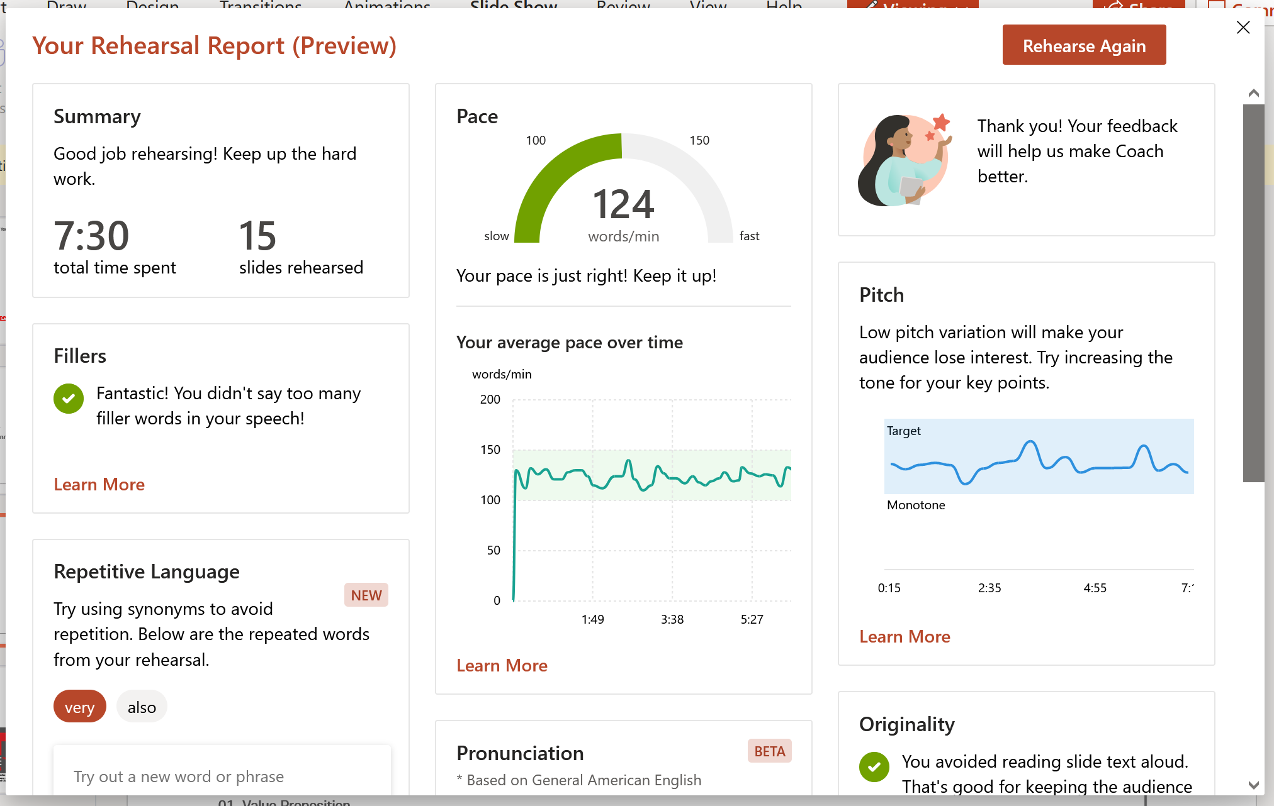
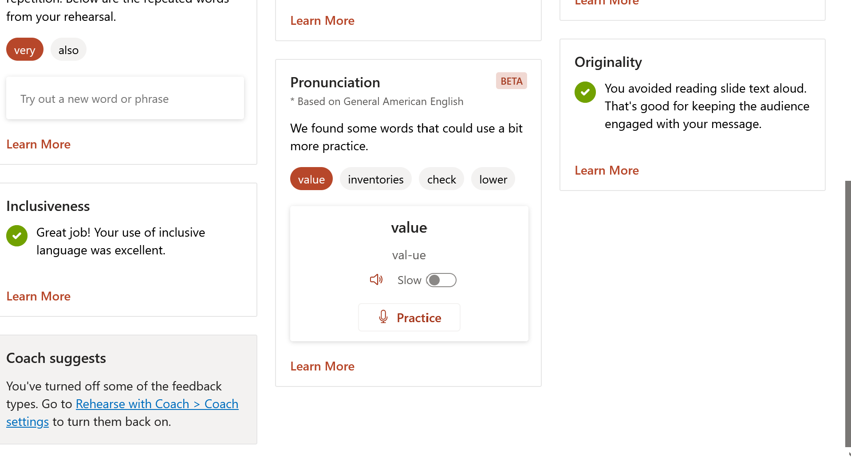
+
15

